Slide 1

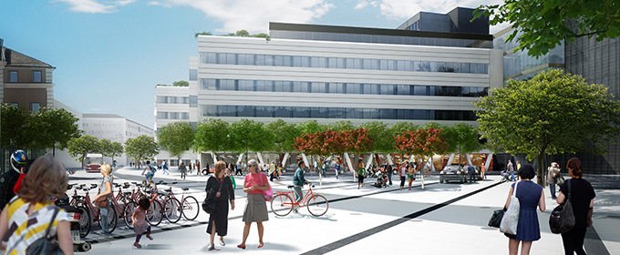
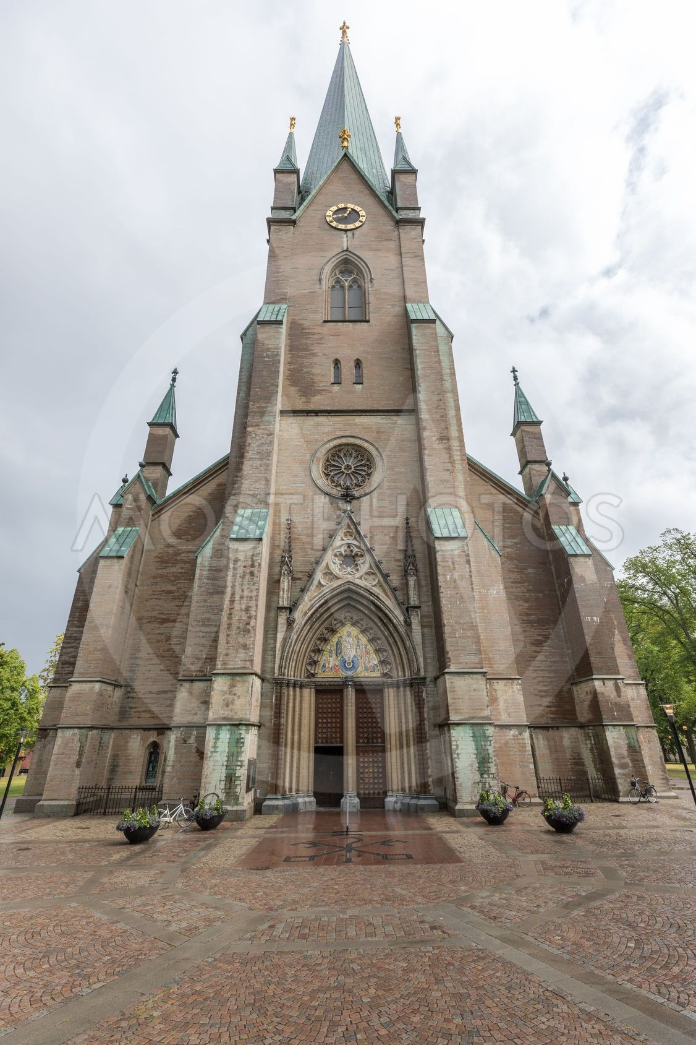

Basic Laparoscopic and Suturing Skills Workshop
Industry partners: Karl Storz, Medtronic, Olympus
Course Director
International Faculty
Marek Soltes (Slovakia)
Dorin Eugen Popa (Sweden, Linköping)
Join us on
31st August – 1st September 2026 at the
Clinicum Training Center, Linköping
The event is organized by the Department of Surgery
within the University Hospital Linköping in partnership with
Swedish Society for Innovation in Surgery (SIKT)
Registrations: popa.dorin.eugen@gmail.com

