Slide 1

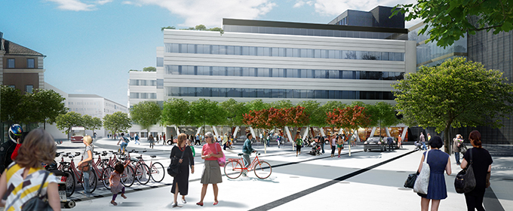
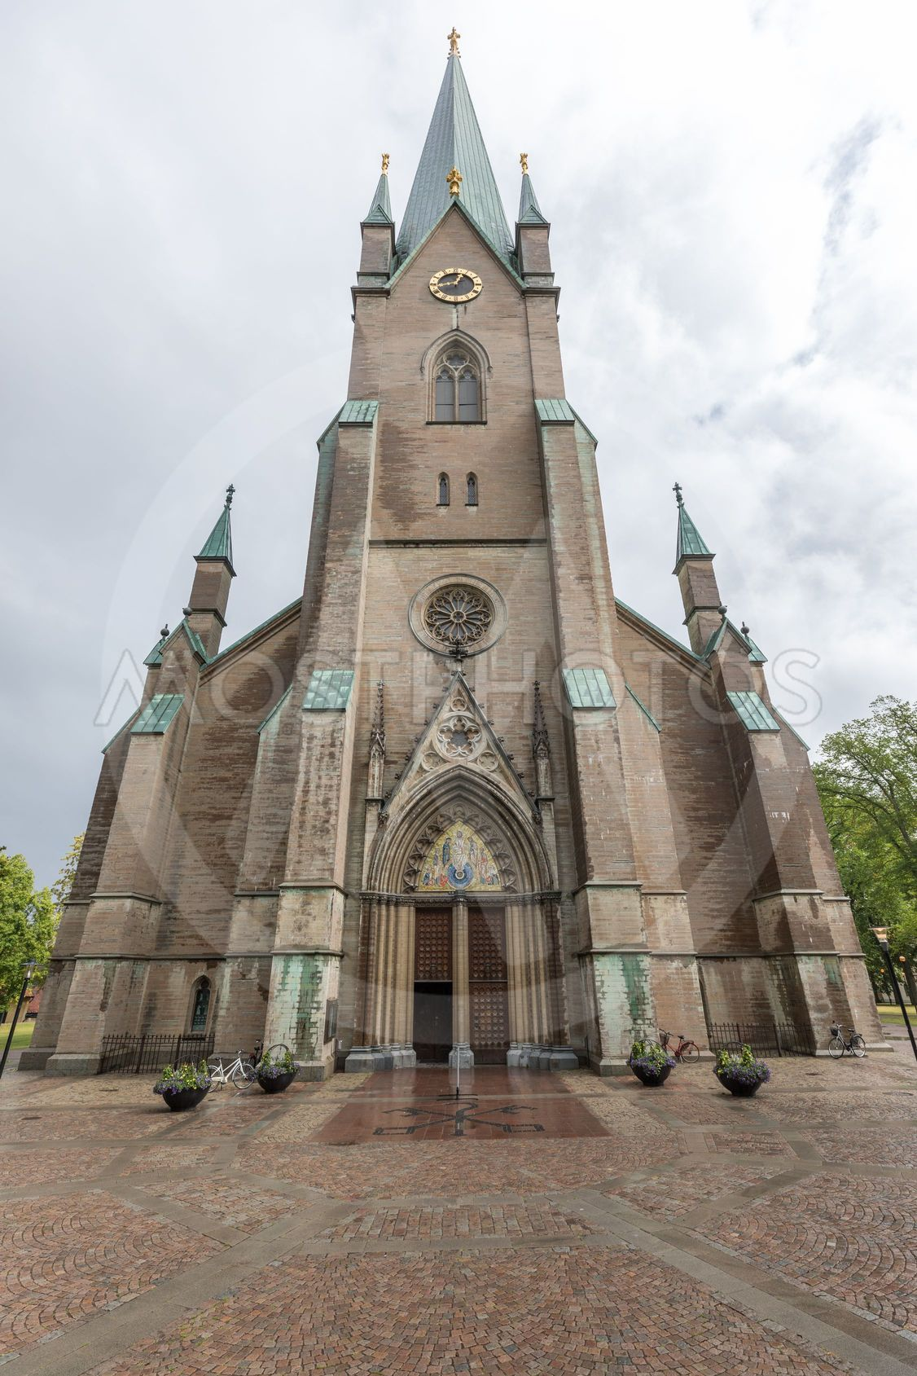

INTERNATIONAL SURGERY WORKSHOP
FOR VISCERAL AND GASTROINTESTINAL EMERGENCIES
(OTHER THAN TRAUMA)
Course Director
Dorin Eugen Popa, MD PhD FEBS MIS
International Faculty
Prof. Tomas Carus (Germany)
Prof. Nicolo de Manzini (Italy)
Dr. Alan Biloslavo (Italy)
Join us on
November, 23th- 24th 2026 at the
Venue: Center for Catastrophes in Medicine (KMC) Linköping
The event is organized by the Department of Surgery
within the University Hospital Linköping in partnership with
Swedish Society for Innovation in Surgery (SIKT)
Registrations: popa.dorin.eugen@gmail.com

